Slide 1
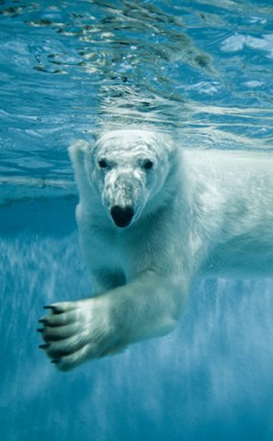

Oulu update
Lots of MXLIMS schema work (shipments)
Reusable MXLIMS PHP toolset
IceBear can generate (but not send) MXLIMS ShipmentMessages
Common endpoints and auth need thought
Thanks Rasmus, Dennis, May, Zac, Guilherme!
https://www.lifeinnorway.net/polar-bear-pictures/

